Slide 1


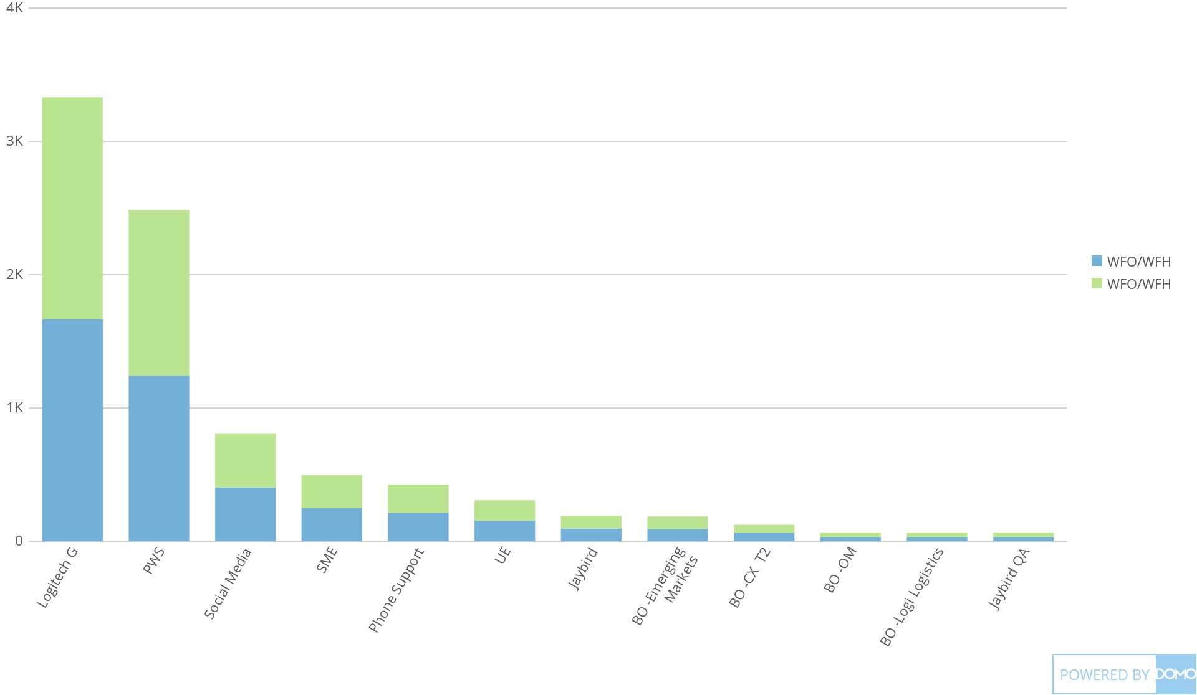
+
exported Apr 6, 2025, 12:53:00 AM MDT
WFO |and |WFH
Jan 1, 2025 - Jan 31, 2025
4,269 Count of WFO/WFH

